Slide 1
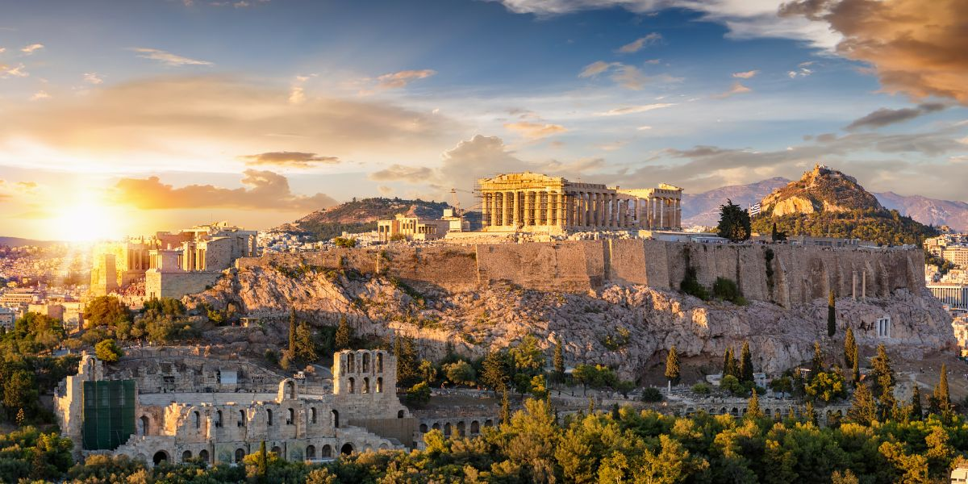
Historic Places in Greece
Αn original presentation prepared by the HELLENIC CULTURE CENTRE VIP Project EU 6

Slide 2
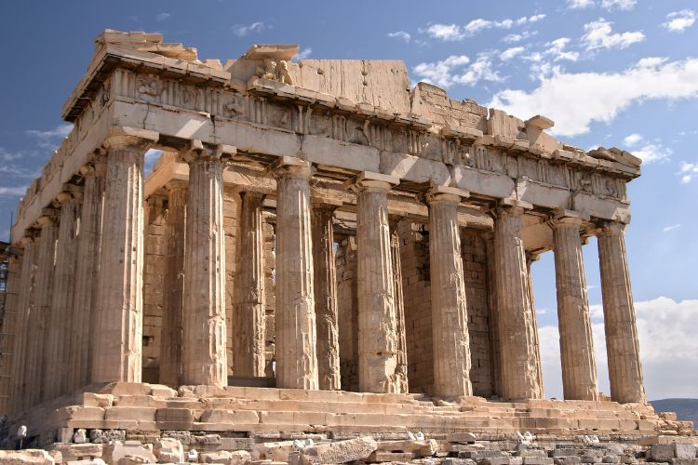
The Acropolis of Athens
The Acropolis is not just home to the Parthenon; it houses several other significant structures such as the Erechtheion, the Temple of Athena Nike, and the Propylaea.
A lesser-known fact is that the olive trees surrounding the site symbolize Athena’s gift to the city, according to mythology

Slide 3
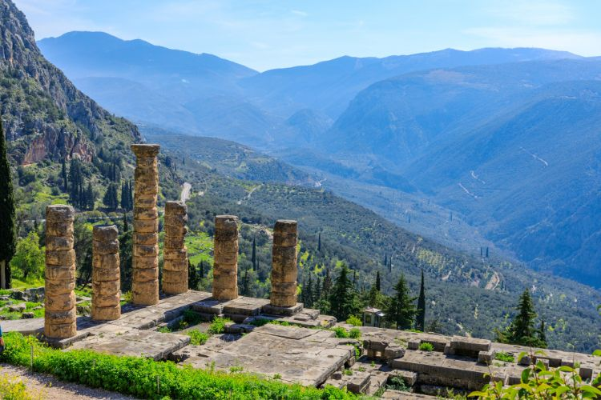
Delphi
Delphi was considered the center of the world in ancient Greek religion, marked by the omphalos, or navel stone.
Beyond its famous oracle, Delphi was also a site for the Pythian Games, similar in prestige to the Olympic Games.

Slide 4
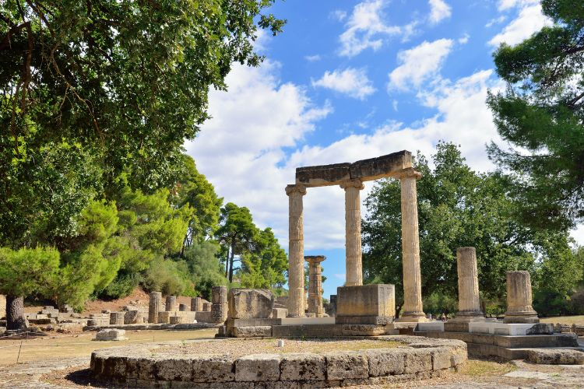
Olympia
Olympia is the birthplace of the Olympic Games, first held in 776 BC.
The site features the Temple of Hera, where the Olympic flame is still lit every four years for the modern Games.
An intriguing fact is the workshop of Phidias, where the colossal statue of Zeus, one of the Seven Wonders of the Ancient World, was crafted

Slide 5
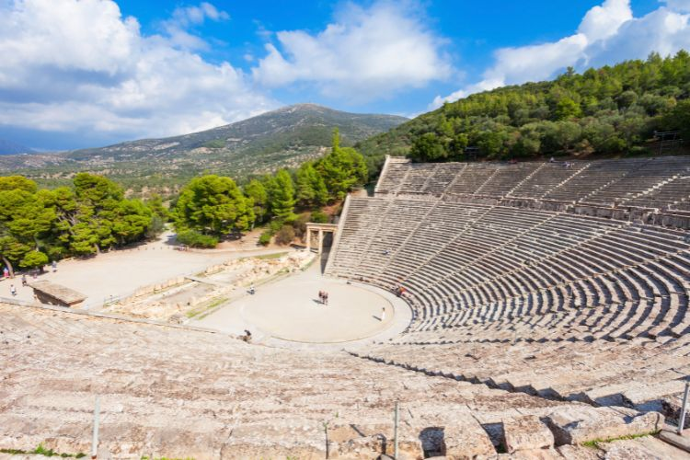
Epidaurus
The site was dedicated to Asclepius, the god of medicine.
Pilgrims visited the sanctuary to seek cures for ailments, participating in healing rituals that included theater performances, believed to be therapeutic.

Slide 6
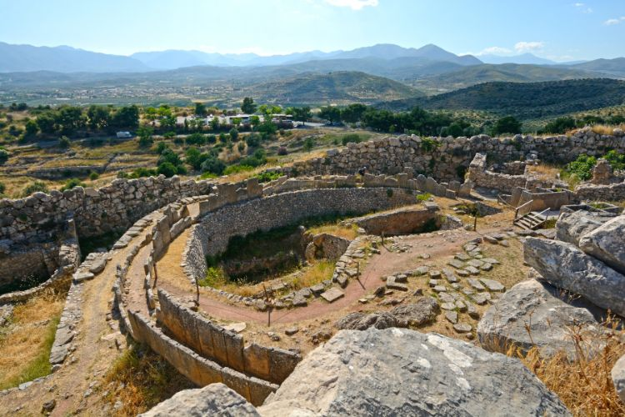
Mycenae
Mycenae is linked to Homer’s epic tales, believed to be the kingdom of Agamemnon.
Archaeological discoveries, such as the Mask of Agamemnon, highlight the wealth and sophistication of Mycenaean civilization.

