Slide 1
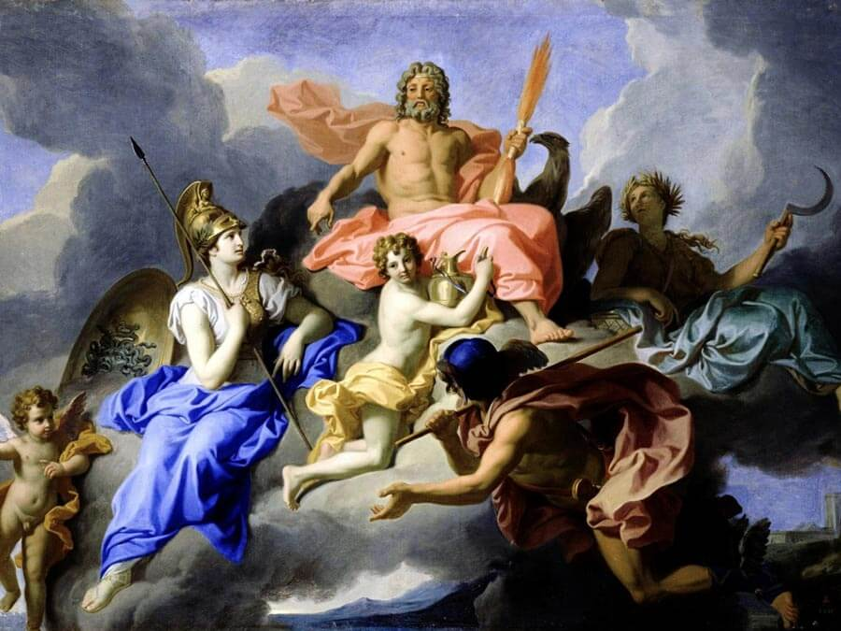
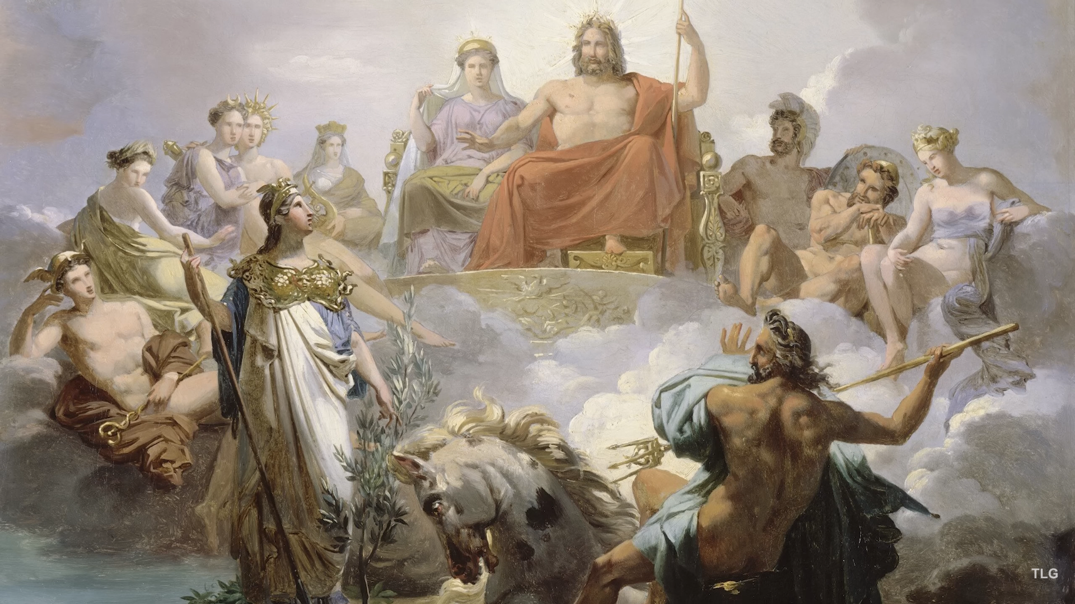
Greek Mythology
Αn original presentation prepared by the HELLENIC CULTURE CENTRE VIP Project EU 21

Slide 2
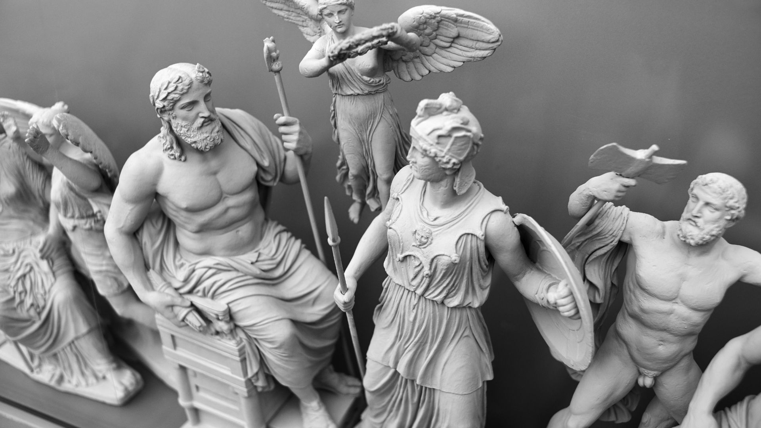
Greek Mythology
The basics of Greek mythology are the gods and goddesses and their mythical history.
The stories found in Greek mythology are colorful, allegorical, and include moral lessons for those who want them
They include human truths and the basics of western culture

Slide 3
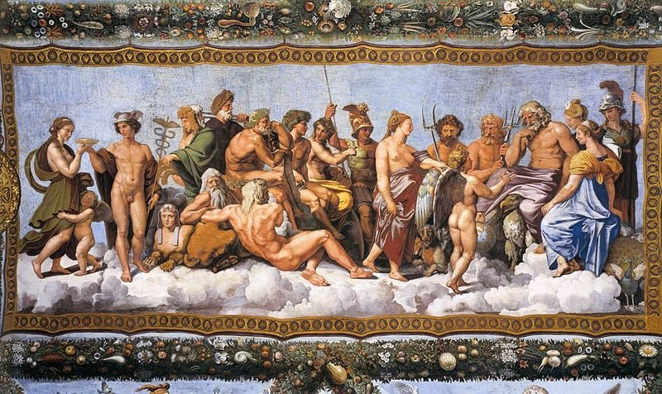
The Olumpians
In ancient Greek religion and mythology, there were 12 gods called Zeus, Hera, Poseidon, Demeter, Athena, Apollo, Artemis, Ares, Hephaestus, Aphrodite, Hermes, and either Hestia or Dionysus.
They were called 'Olympians' because they lived in Mount Olympus.
They were immortal but looked and behaved like humans.

Slide 4
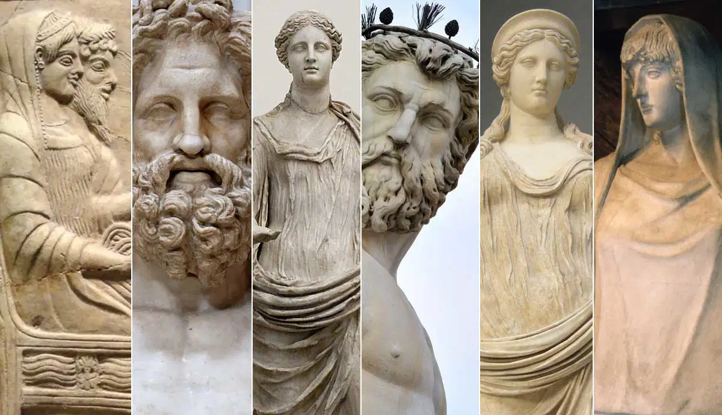
The Olympians
The twelve main Olympians are:
Zeus (Jupiter, in Roman mythology): the king of all the gods (and father to many) and god of weather, law and fate
Hera (Juno): the queen of the gods and goddess of women and marriage
Aphrodite (Venus): goddess of beauty and love
Apollo (Apollo): god of prophesy, music and poetry and knowledge
Ares (Mars): god of war

Slide 5
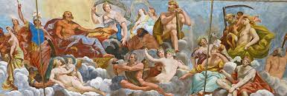
The Olympians
Artemis (Diana): goddess of hunting, animals and childbirth
Athena (Minerva): goddess of wisdom and defense
Demeter (Ceres): goddess of agriculture and grain
Dionysus (Bacchus): god of wine, pleasure and festivity
Hephaestus (Vulcan): god of fire, metalworking and sculpture
Hermes (Mercury): god of travel, hospitality and trade and Zeus’s personal messenger
Poseidon (Neptune): god of the sea

Slide 6
Other heroes, men and women are just as significant
Heracles, the adventurer who performed 12 impossible labors for King Eurystheus
Pandora, the first woman, whose curiosity brought evil to mankind;
Pygmalion, the king who fell in love with an ivory statue;
Arachne, the weaver who was turned into a spider for her arrogance;
handsome Trojan prince Ganymede who became the cupbearer for the gods;
Midas, the king with the golden touch;
Narcissus, the young man who fell in love with his own reflection;
Kratos, a god of strength and power

