Slide 1
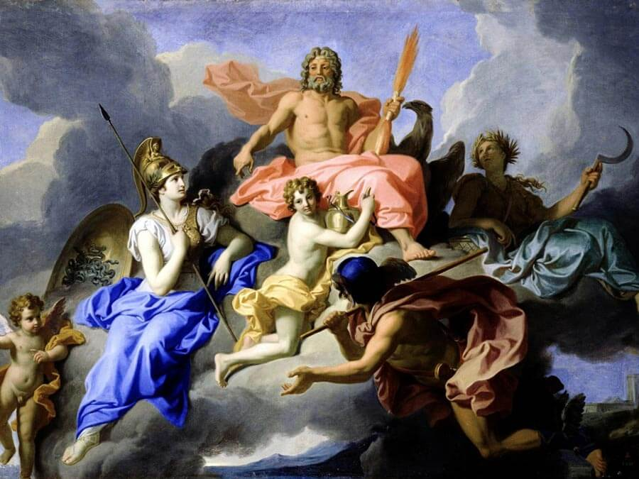
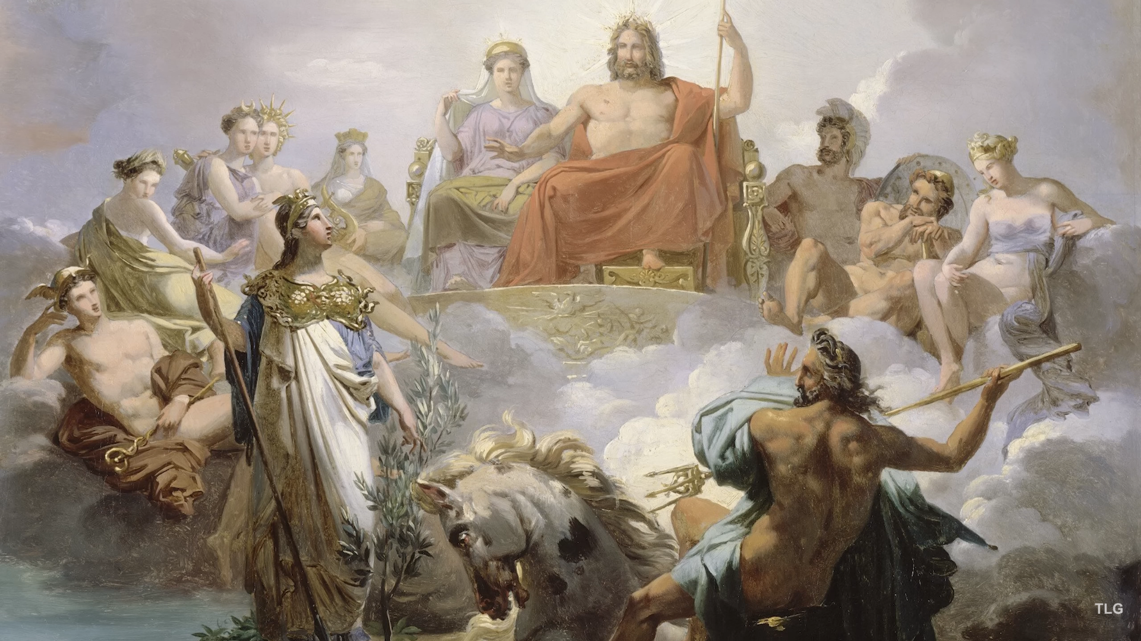
Greek Mythology
Αn original presentation prepared by the HELLENIC CULTURE CENTRE VIP Project EU 22

Slide 2
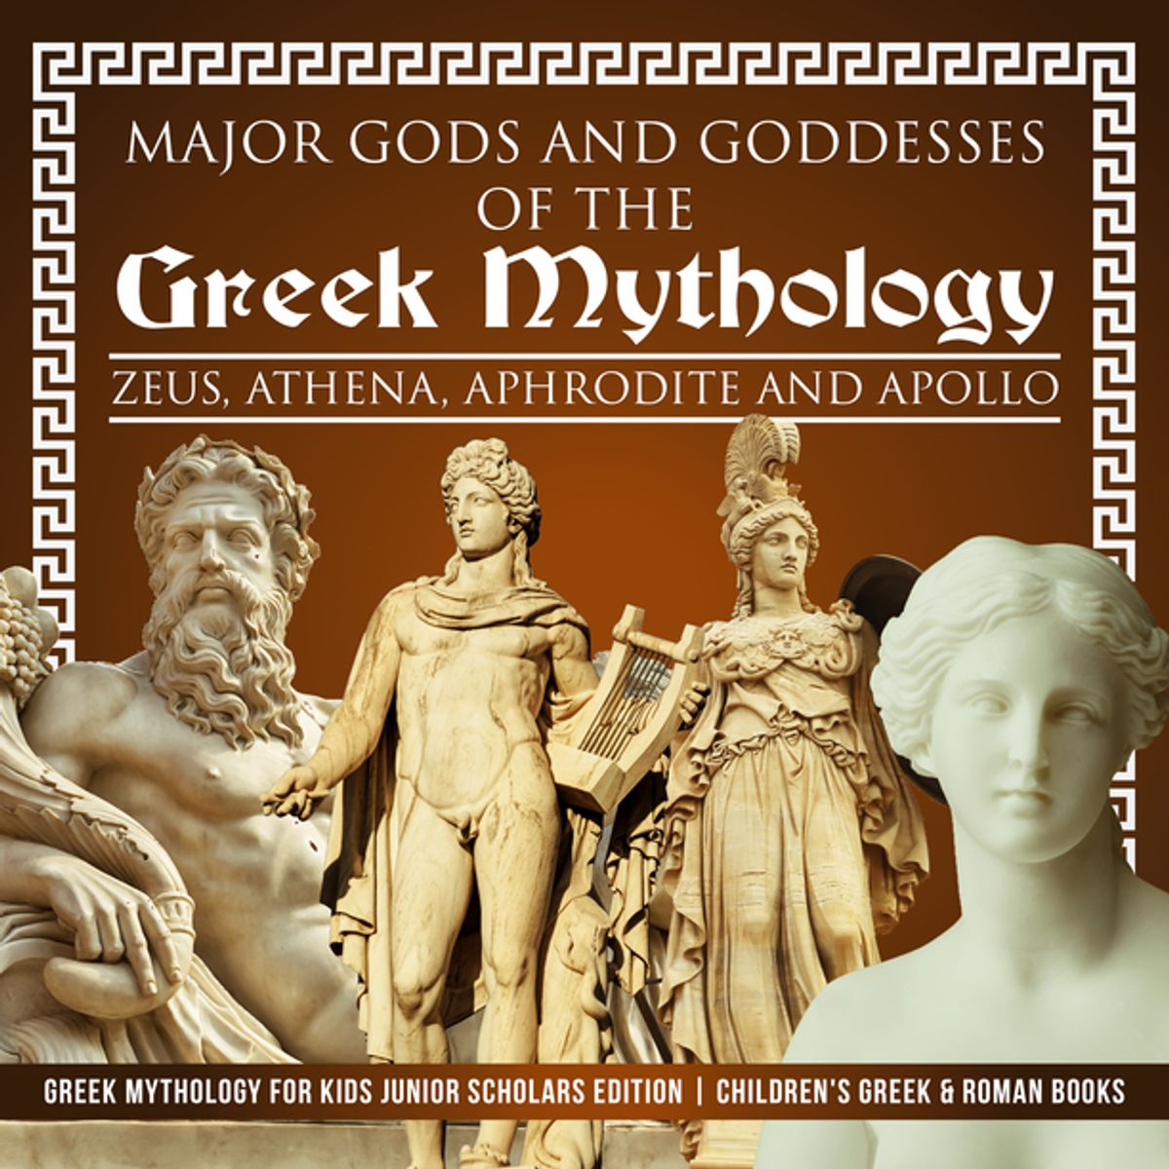
Greek Mythology
Greek mythology originated as oral literature, or stories told out loud.
The ancient Greeks told their myths over and over again before they were written down.

Slide 3
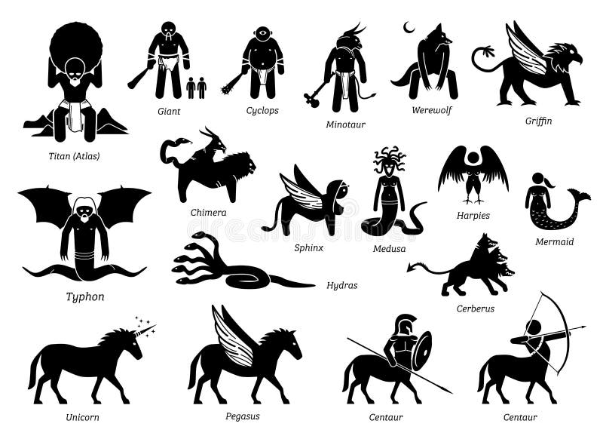
Monsters and “hybrids” (human-animal forms)
the winged horse Pegasus, the horse-man Centaur,
the lion-woman Sphinx
the bird-woman Harpies,
the one-eyed giant Cyclops,
automatons (metal creatures given life by Hephaestus),
unicorns, Gorgons, pygmies, minotaurs, satyrs and dragons of all sorts.

Slide 4
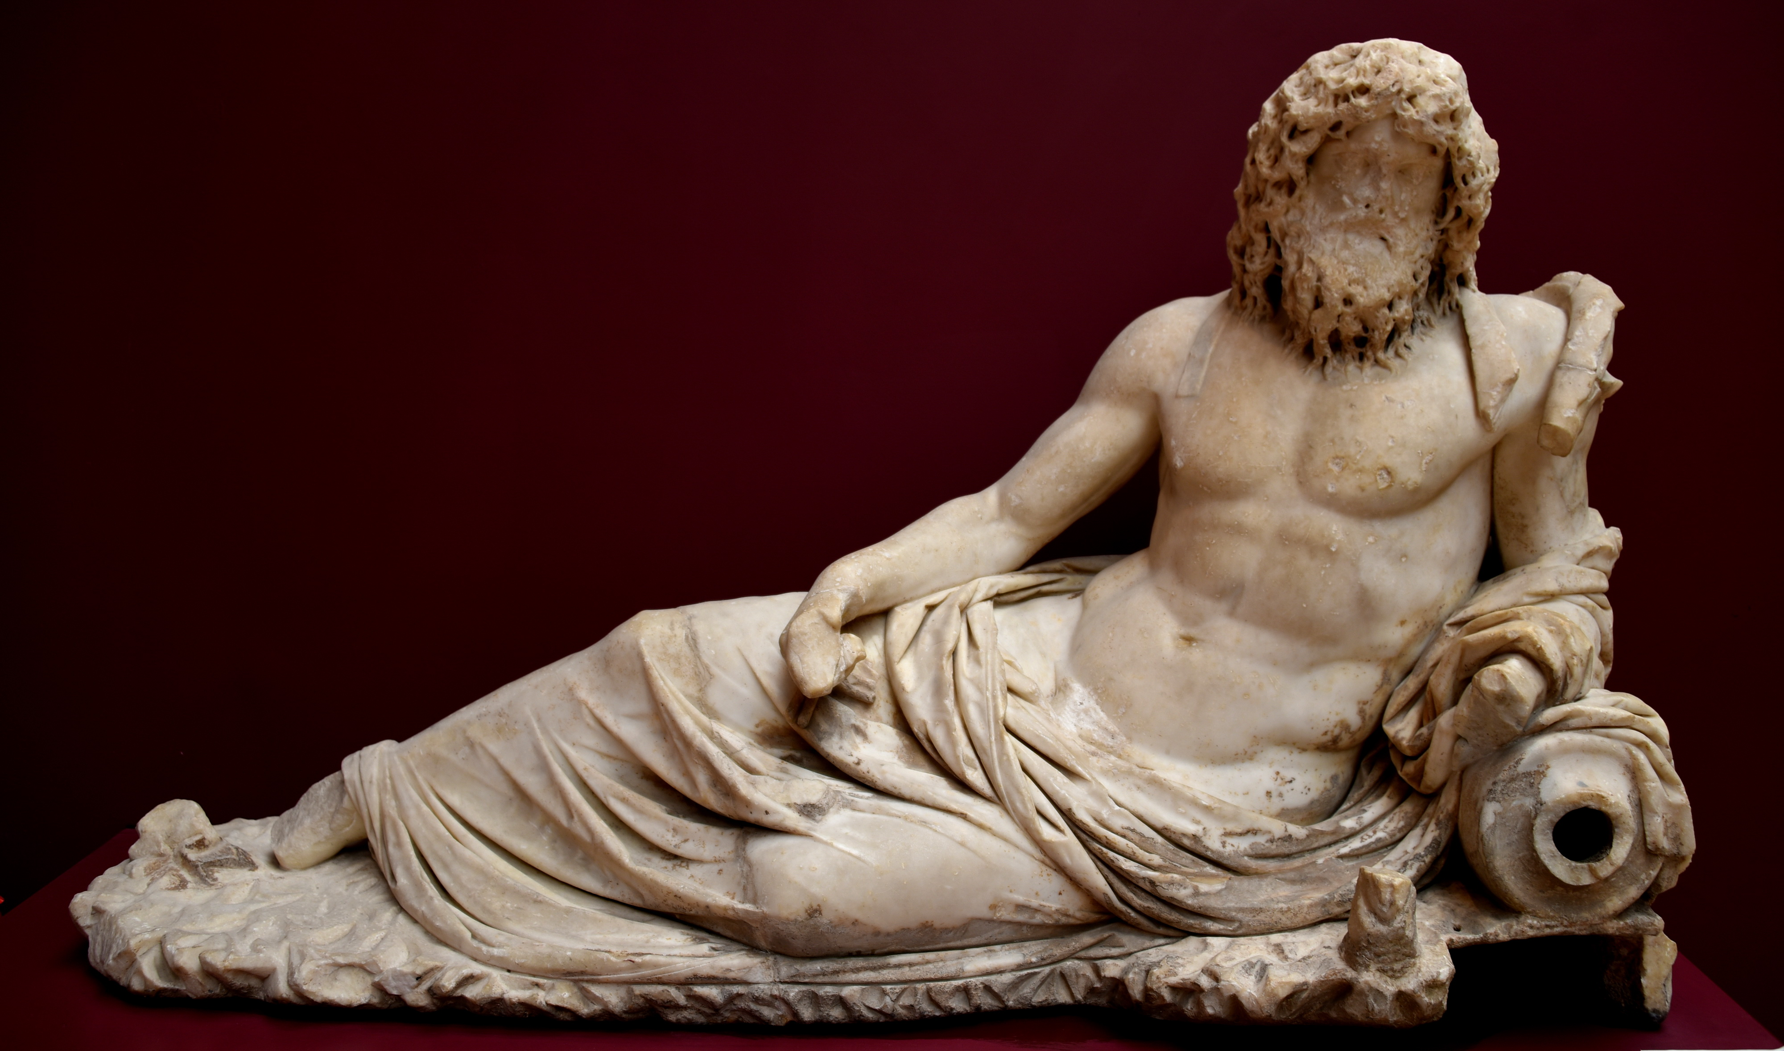
Earth, Ocean, and sun
The ancient Greeks viewed Earth as a flat disk afloat on the river of Ocean.
The Sun (Helios) traveled across the heavens in a chariot by day and sailed around Earth in a golden bowl at night.

Slide 5
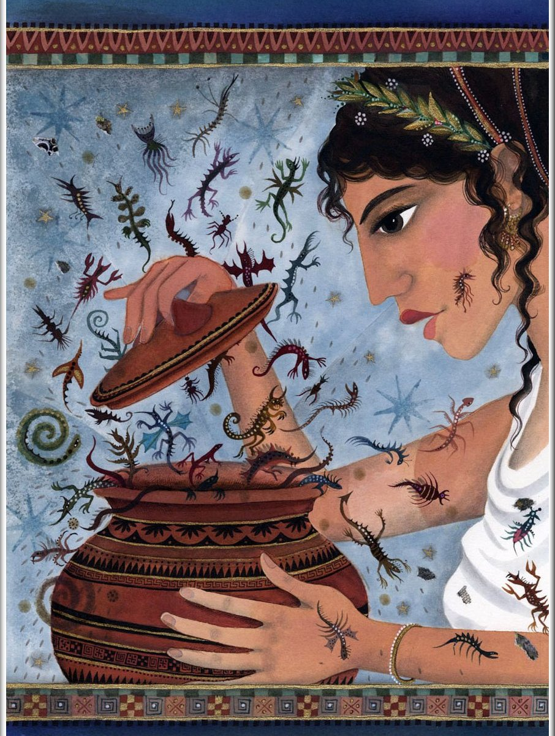
Pandora’s box
Hesiod explained the presence of evil in the world through the story of Pandora, the first woman on Earth.
Prometheus, a fire god and divine trickster, had stolen fire from heaven and given it to mortal men.
This gift angered Zeus, and he had Pandora created as punishment. Pandora had a mysterious jar that her husband ordered her not to open.
Out of curiosity, she opened it anyway, and evils, hard work, and disease flew out to plague humanity.
Only hope remained in the jar.

Slide 6
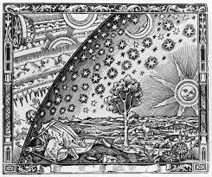
Cosmos=the world (means beauty)
Like the myths of many other cultures, those of ancient Greece tell how the world was created and help explain why things happen.

Slide 7
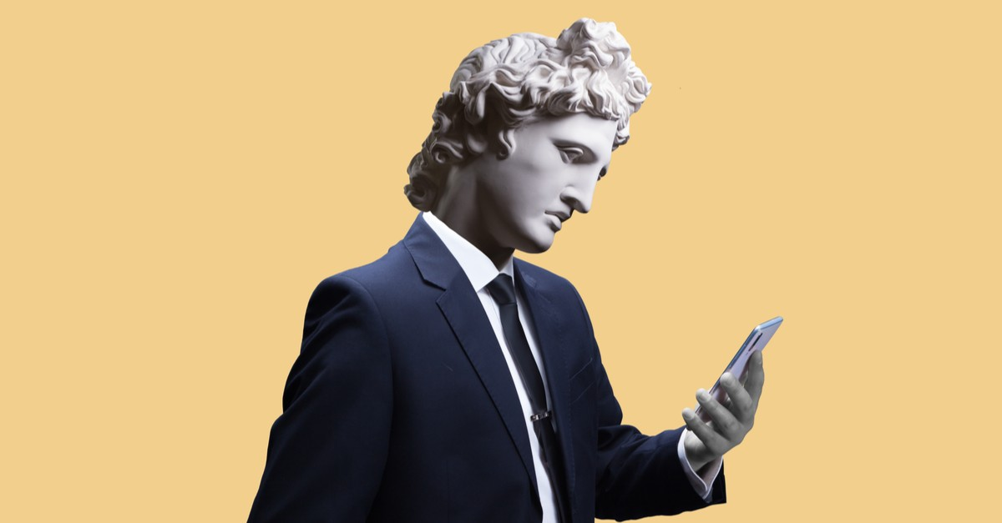
Impact
The characters, stories, themes and lessons of Greek mythology have shaped art and literature for thousands of years.
They appear in Renaissance paintings such as Botticelli’s Birth of Venus and Raphael’s Triumph of Galatea and writings like Dante’s Inferno;
Romantic poetry and libretti; and scores of more recent novels, plays and movies.
Today Greek Mythology inspires us

