Slide 1
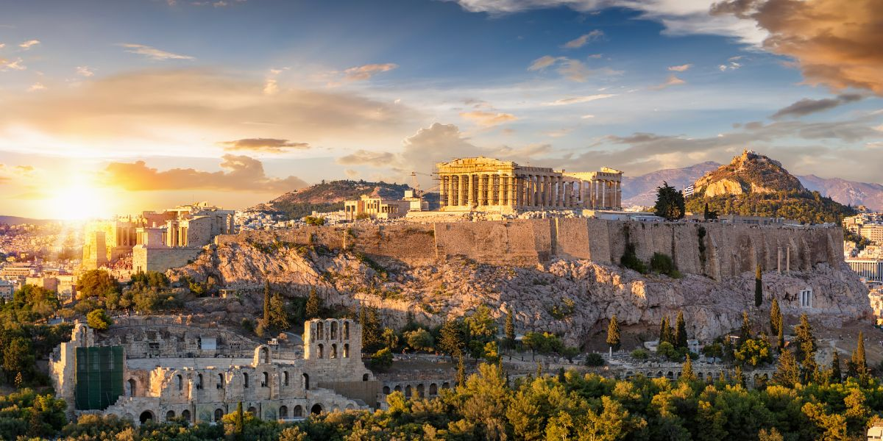
Historic Places in Greece
Αn original presentation prepared by the HELLENIC CULTURE CENTRE VIP Project EU 6

Slide 2
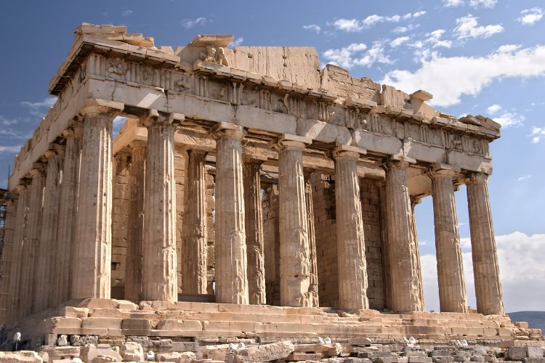
The Acropolis of Athens
There are Acropolises all over Greece. Acropolis of Athens.
The Acropolis of Athens is very famous all over the world. Parthenon is at the top of the Acropolis. Actually, the Acropolis is the rock and the Parthenon is the temple. It houses several other significant structures such as the Erechtheion, the Temple of Athena Nike, and the Propylaea.
It is a universal symbol. The access to the top is easy. The pathways are easy to walk and there are facilities especially for disabled people..
There are lots of olive trees in the area. The olive tree symbolizes Athena’s gift to the city, according to mythology.

Slide 3
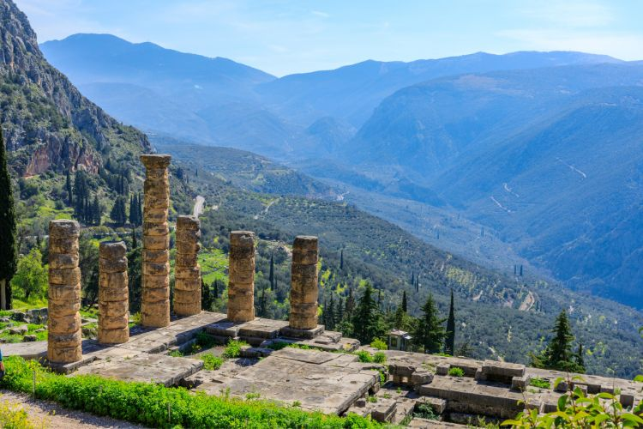
Delphi
It was the 'omphalos' the navel of the world. It was a religious centre in the 6th century. The famous oracle of Delfi was there.
Delphi was also a site for the Pythian Games, similar in prestige to the Olympic Games.

Slide 4
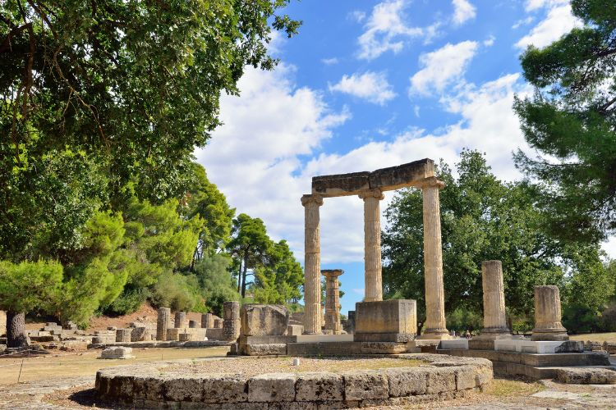
Olympia
Olympia is the birthplace of the Olympic Games, first held in 776 BC.
The site features the Temple of Hera, where the Olympic flame is still lit every four years for the modern Games.

Slide 5
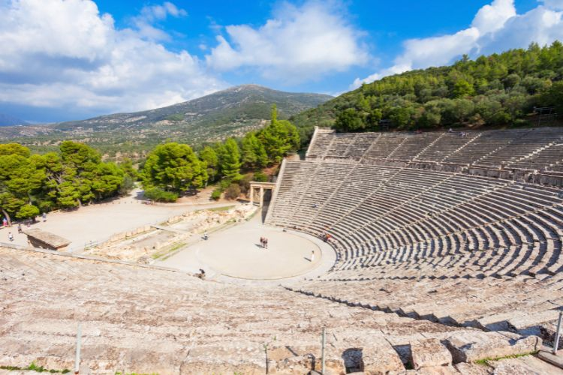
Epidaurus
The site was dedicated to Asclepius, the god of medicine.
Travelers visited the sanctuary(a part of the church) to seek cures for illnesses, participating in healing rituals that included theater performances, believed to be therapeutic.

Slide 6
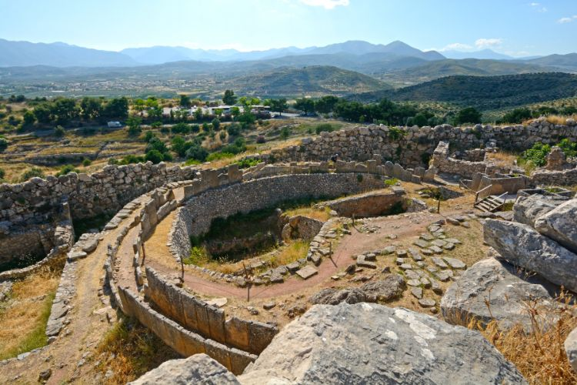
Mycenae
The archeological sites of Mycenae and Tires played an important role in the development of classical Greek culture. Homer wrote about the cities in The Iliad and The Odyssey.

